Slide 1
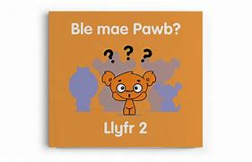
Darllen Llyfrau Cymraeg yn y Tŷ
Reading Welsh Books at Home

Slide 2

Clawr y Llyfr Book Cover
gwasg – book press
teitl - title
llun - picture
awdur - author
darlunydd - illustrator

Slide 3

Y Lluniau
The Pictures
Beth wyt ti'n gweld yn y llun? What can you see in the picture?
Tybed, beth sy'n digwydd. I wonder what's happening.
Pwy ydyn nhw? Who are they?
Ble maen nhw? Where are they?
Beth maen nhw'n gwneud? What are they doing?
Sut mae … yn teimlo? I wonder how … is feeling.
Beth sy'n mynd i ddigwydd nesaf? What will happen next?

Slide 4
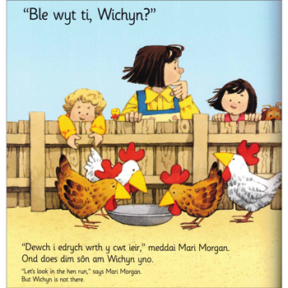
Y Geiriau
The Words
Ble mae’r llythyren…? Where’s the letter…?
Ble mae’r gair…? Where is the word…?
Pa air sy’n dechrau’r frawddeg? What word starts the sentence?
Beth yw ystyr y gair…? What’s the meaning of the word…?
Beth sy’n digwydd? – What’s happening?
Sut mae… yn teimlo? How does … feel?
Beth fydd yn digwydd nesaf? What will happen next?

Slide 5

Trafod y Llyfr Discussing the Book
Wyt ti’n cofio…? Do you remember…?
Beth ddigwyddodd? What happened?
Pwy oedd dy hoff gymeriad? Who was your favourite character?
Beth oedd dy hoff ddarn? What was your favourite part?
Beth oeddet ti’n meddwl am y llyfr? What did you think of the book?
Sawl seren? How many stars?

Slide 6
Geirfa
Vocabulary
llyfr | book | darllen | read
llun | picture | brawddeg | sentence
awdur | author | paragraff | paragraph
darlunydd | illustrator | atalnod llawn | full stop
cylchgrawn | magazine / comic | atalnod | comma
papur newydd | newspaper | dyfynodau | quotation marks
nofel | novel | cymeriad | character
ffuglen | fiction | lleoliad | setting
ffeithiol | factual | darllenydd | reader
clawr | cover | llyfrgell | library
broliant | blurb | dewis | choose
teitl | title | e-lyfr | e-book
tudalen | page | barddoniaeth | poetry
pennod | chapter | dirgel | mystery
cyfres | series | comedi | comedy
llythyren | letter | arswyd | horror
gair | word

