Slide 1
Cynradd
An aid to use Everyday Welsh in a primary school setting
Cymraeg
ar dy dafod
Sesiwn 5 / Session 5: Ble mae…?/ Where is…?
Addasiad o gynllun Catrin Phillips, Awdurdod Addysg Sir Benfro

Slide 2
Gwers 5 Ble?
Cymraeg
ar dy dafod
Ble mae Sinsir ?
Where is Ginger ?
Ydy Sinsir yn y bocs?
Is Ginger in the box?
Ydy Nac ydy
y ddesg
y drws
y cwpwrdd
y gadair
y bocs
y llawr
y bwrdd
y silff
y stordy
the desk the door
the cupboard the chair
the box the floor the table the shelf
the storeroom
yn
wrth
ar
o dan
o flaen
tu ôl i’r

Slide 3
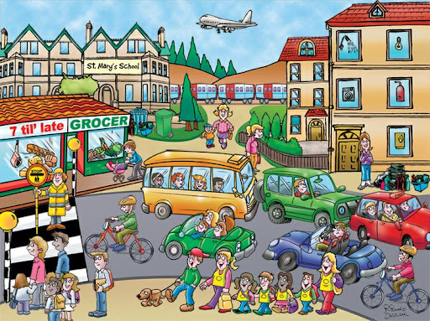
Ble mae’r…?
dyma’r… - here’s the…
ydy e / hi – is it / he / she..?
yn y– in the
wrth y– by the
ar y– on the
o dan y – under the
o flaen y – in front of the
tu ôl i’r – behind the
plant – children
dyn – man
menyw – woman
person lolipop – lollipop person
siop – shop
ysgol – school
bws – bus
car – car
beic – bike
awyren – aeroplane
trên – train
tacsi - taxi
pram - pram
sbwriel – rubbish
Coed - trees

Slide 4
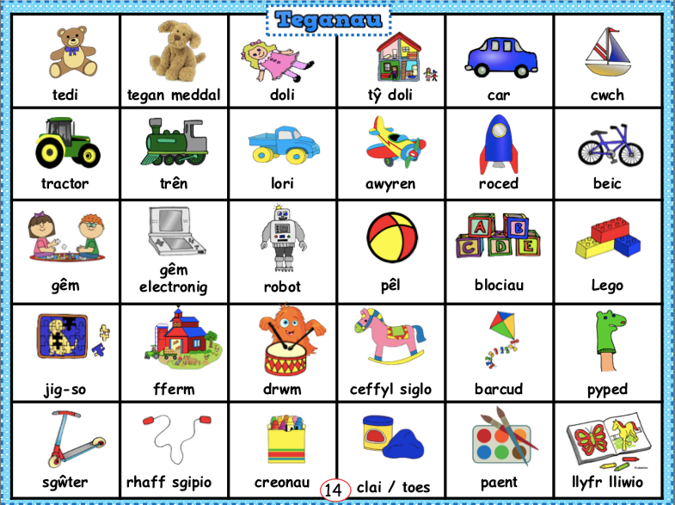
Ble mae’r… teganau

